Slide 1
Supertroupers
Gravitation Episode
Teaching material
Gravitation episode, Supertroupers, Lau Bergey and Barbara Govin, Stimuli Eds, 2023.
Stimuli has received support from the European Union under the Eramsus+ programme and project number 2021-1-FR01-KA220-SCH-000030110.

Slide 2
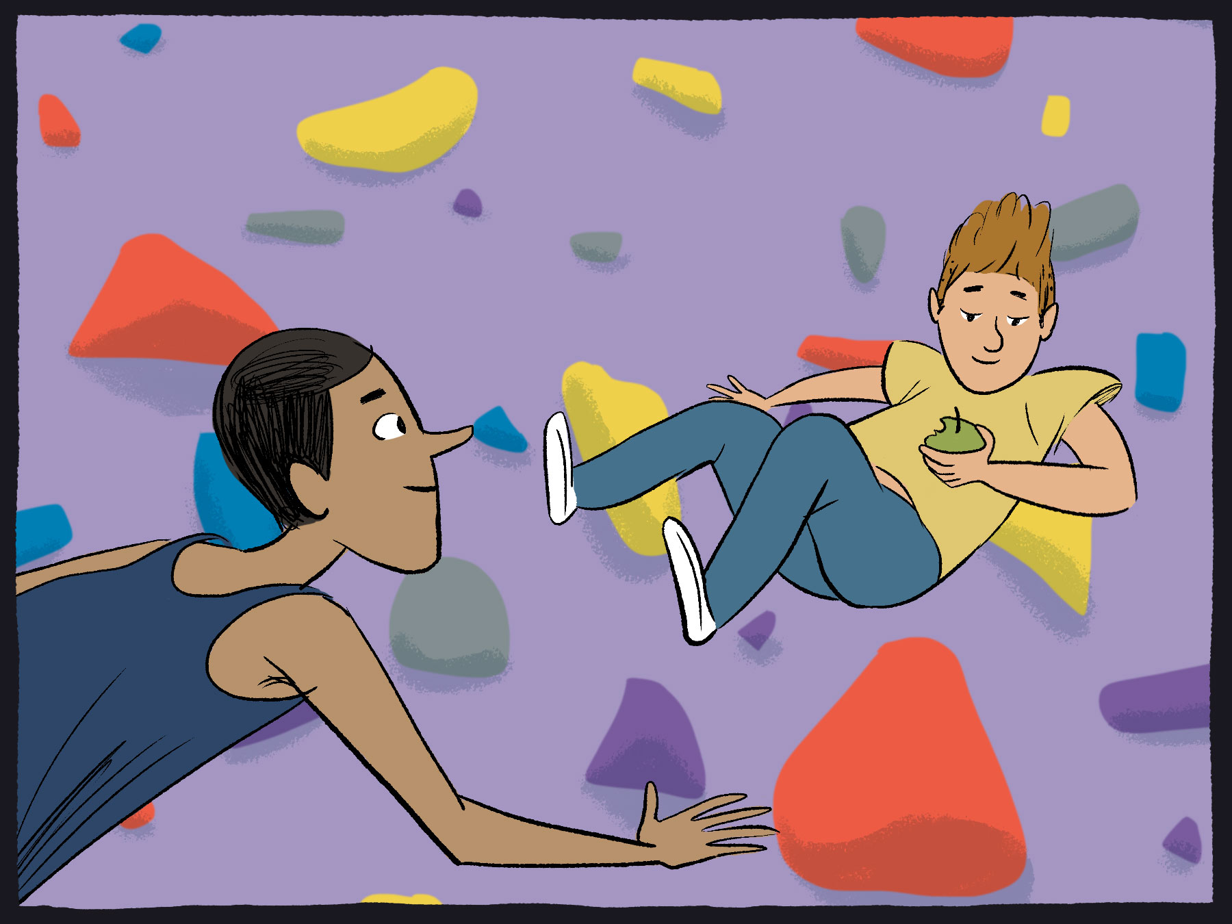
Chapter 2, p.8
When Tom loosens his fingers, should the apple fall faster, slower or in the same way as the characters? Why ?or

Slide 3
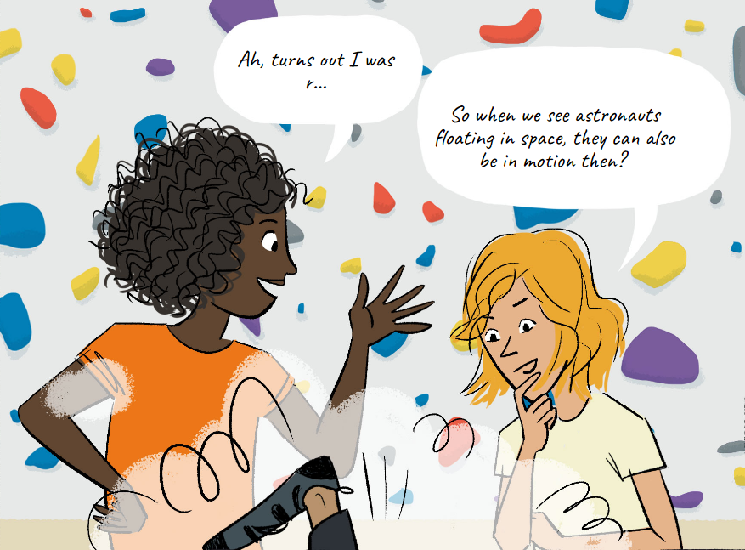
Chapter 2, p.13
To your opinion, how can an astronaut in weightlessness in space be also in motion?

Slide 4
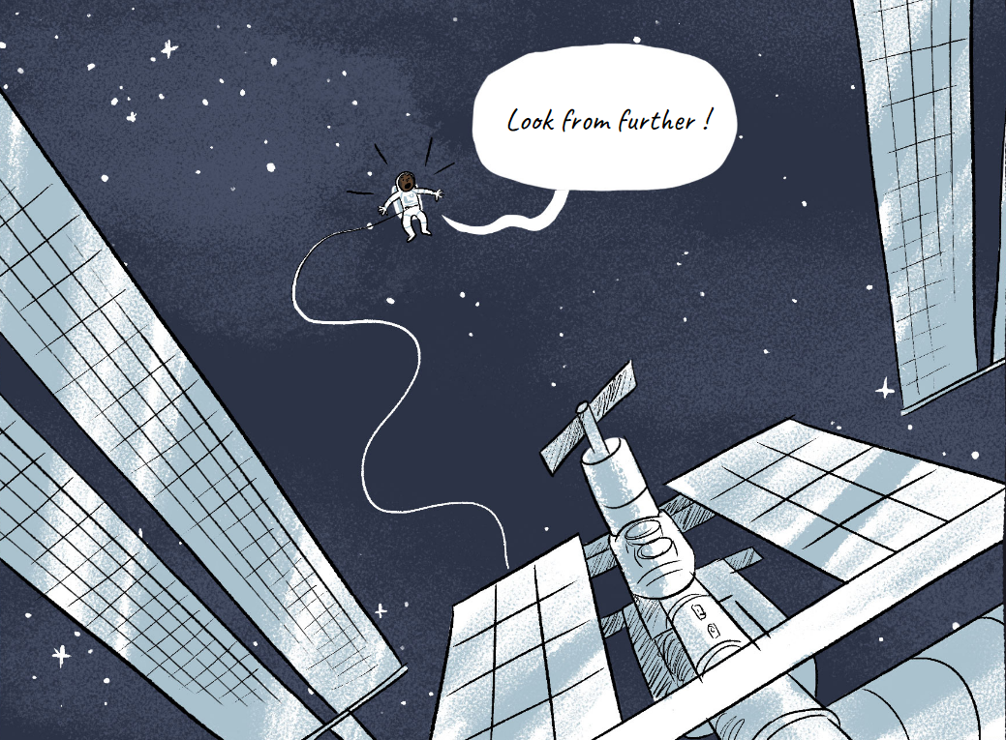
Chapter 2, p.16
What do you think the mass of a space station could be?

Slide 5
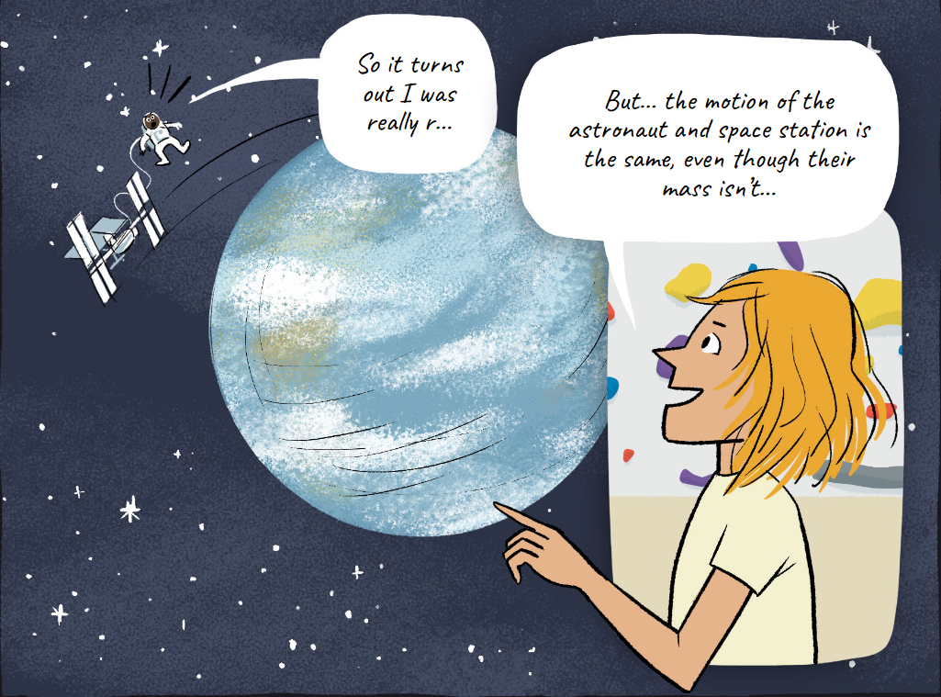
Chapter 2, p.20
What does this feature make you think of ?

Slide 6
Questions about the scenes in chapter 2 p.8: When Tom loosens his fingers, does the apple fall faster, slower or in the same way as the characters? Why or why not? ................................................................................................................................................................................................................................
p.8: According to the image on p.8, why can we say that the characters and the apple are weightless, like astronauts? ................................................................................................................................................................................................................................ p.13: To sum up: You can be weightless from one point of view (that of Titouan and Tom, who are falling), and in motion from another point of view (that of Diane and Iris, on the ground).
p.13: According to the previous conclusion, how can an astronaut in weightlessness in space be in such motion? ................................................................................................................................................................................................................................ p.15: In relation to what might the astronaut be moving? ................................................................................................................................................................................................................................ p.16: What do you think the mass of a space station could be? ............................................................................................... (for example, the ISS in which Thomas Pesquet was stationed)
p.20 : The astronaut and the space station move at the same speed, even though they don't have the same mass at all. What does this make you think of? ................................................................................................................................................................................................................................

Slide 7
Illustration of physics statements and their common points
Under each frame on the left, write down the page(s) of the comic book that illustrate(s) the framed sentence.
Link the different observations on the left to the common points on the right.
Objects fall at the same speed regardless of their mass.
Comic page(s) illustrating this sentence: .....................
What do falling and orbital motion have in common?
A person who falls, from their own point of view, is weightless.
In both cases, from the point of view of moving bodies, the objects are in a state of weightlessness. objects are in a state of weightlessness.
Comic page(s) illustrating this sentence: .........................
The astronaut is weightless from the point of view of the space station, but from the point of view of the centre of the Earth, the astronaut and the space station are in circular motion around the Earth (orbital motion).
In both cases, bodies with different masses move at the same speed.
Comic page(s) illustrating this sentence: .........................
=> How can we explain the similarities between falling and orbital motion?
The astronaut and the space station have the same movement, even though they don't have the same mass at all.
Comic page(s) illustrating this sentence: .........................

Slide 8
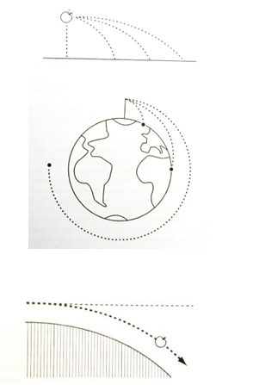
Document A
An explanation of Newton's diagram
Extract from the book "Newton's apples" (2003) by Jean Marie Vigoureux
"If I take into account the spherical shape of the Earth, I will see that, in the end, if I were able to throw this apple with enough force, it would come back to me from behind after circling the Earth.
[...] We can reason in a more quantitative way: a body thrown horizontally falls 5 metres during its first second of fall. Let's suppose that in one second it is propelled far enough so that the ground, because of the sphericity of the earth's surface, has itself dropped 5 metres. Under such conditions, this body will find itself, despite its fall, at exactly the same altitude above the ground as when it was launched."

Slide 9
Document B
From "gravity" to "gravitation
Vertical fall, curved fall and circular motion can all be seen as the same type of motion. Only the initial velocity changes. This helps us to understand, for example, that orbital motion shares the same characteristic as falling: objects of different masses move at the same speed. A space station and an astronaut move at the same speed even though their masses are very different, just as on Earth, two objects of different masses fall at the same speed.
Since vertical and curved fall are associated with gravity, orbital motion can also be associated with gravity. However, as we are accustomed to using the term 'gravity' to refer only to fall to Earth, we use the term 'gravitation' to describe both fall to Earth and orbital motion in space.
The "weight" or "force of gravity" associated with an object falling to Earth then becomes a special case of the "force of gravitation", which also applies to an object orbiting the Earth.

